Slide 1
FixSlicing AES
https://youtu.be/E2DKupsDGok

Slide 2
FixSlicing AES
#AES
#Fixslicing AES
128-Bit
128-Bit
128-Bit
AddroundKey
Packing
SubBytes
Sbox(FixSlice)
ShiftRows
Mixcolumns
round function
round function
Mixcolumns
AddroundKey
AddroundKey
Unpacking
128-Bit
128-Bit
128-Bit

Slide 3
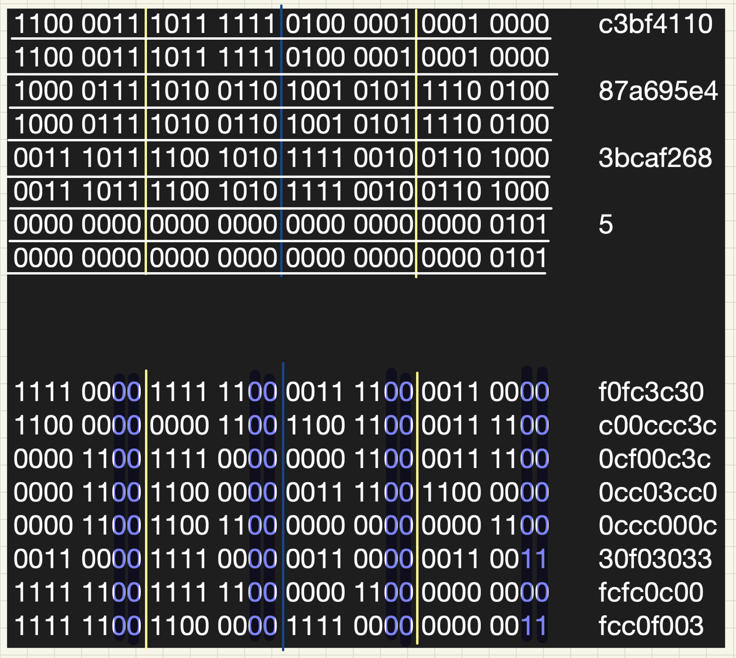
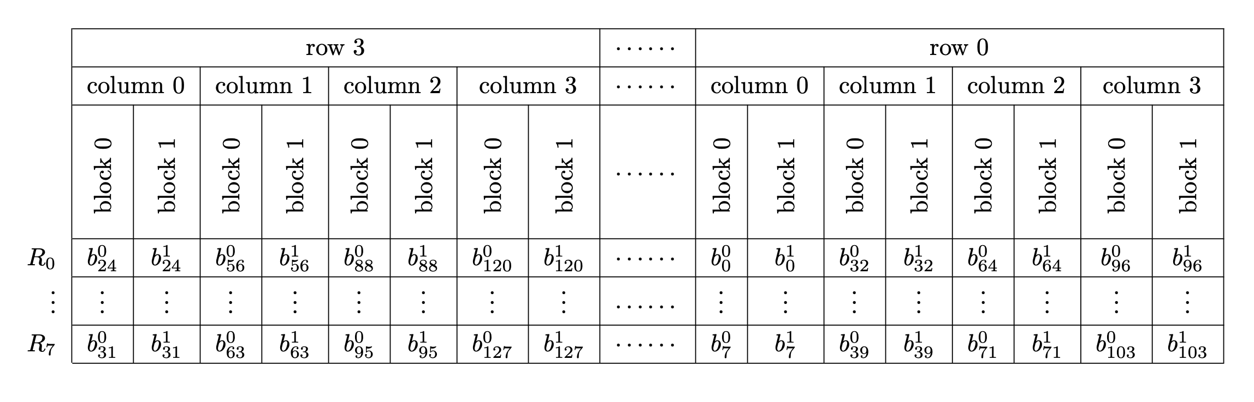
FixSlicing AES – Packing
pt[0]
pt[1]
pt[2]
pt[3]

Slide 4
FixSlicing AES – Packing
COLUMN
0
1
2
3
0
A0 | A4 | A8 | A12
A1 | A5 | A9 | A13
A2 | A6 | A10 | A14
A3 | A7 | A11 | A15
1
ROW3 |  |  |  |  |  |  |  | ROW2 |  |  |  |  |  |  |  | ROW1 |  |  |  |  |  |  |  | ROW0
COL0 |  | COL1 |  | COL2 |  | COL3 |  | COL0 |  | COL1 |  | COL2 |  | COL3 |  | COL0 |  | COL1 |  | COL2 |  | COL3 |  | COL0 |  | COL1 |  | COL2 |  | COL3
A03 | B03 | A07 | B07 | A11 | B11 | A15 | B15 | A02 | B02 | A06 | B06 | A10 | B10 | A14 | B14 | A01 | B01 | A05 | B05 | A09 | B09 | A13 | B13 | A00 | B00 | A04 | B04 | A08 | B08 | A12 | B12
2
3
state[0]
ROW
0
1
2
3
0
B0 | B4 | B8 | B12
B1 | B5 | B9 | B13
B2 | B6 | B10 | B14
B3 | B7 | B11 | B15
1
2
3

Slide 5
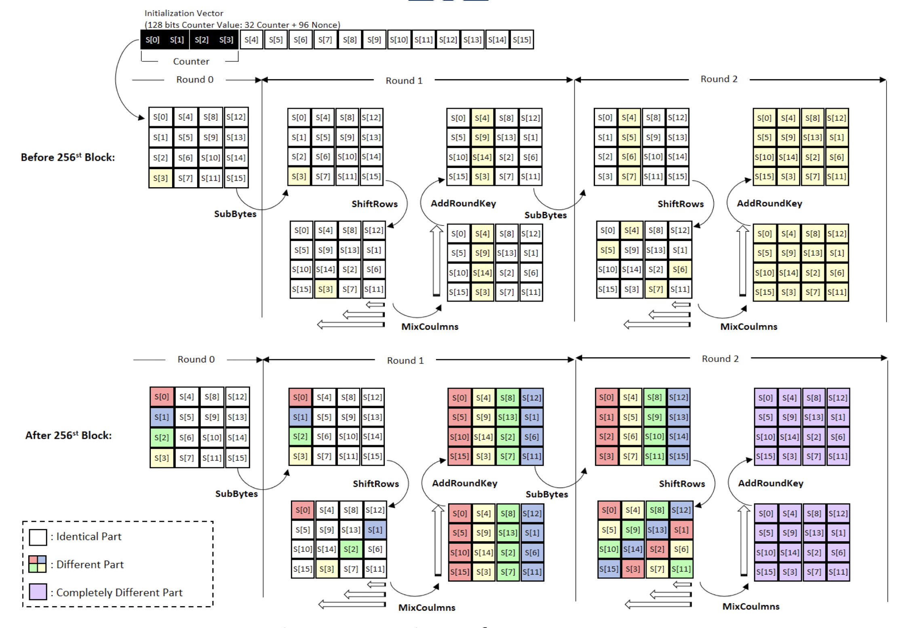
FixSlicing AES – CTR

Slide 6
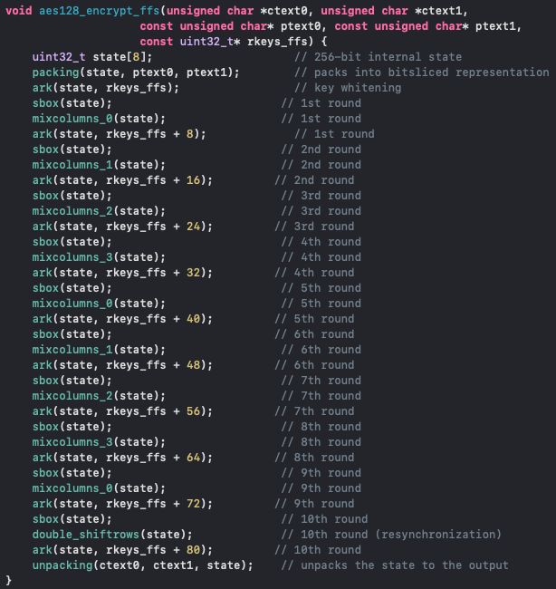
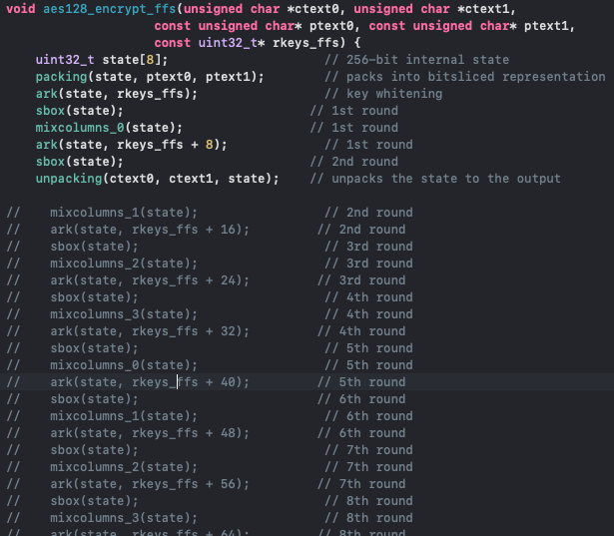
FixSlicing AES – CTR

Slide 7
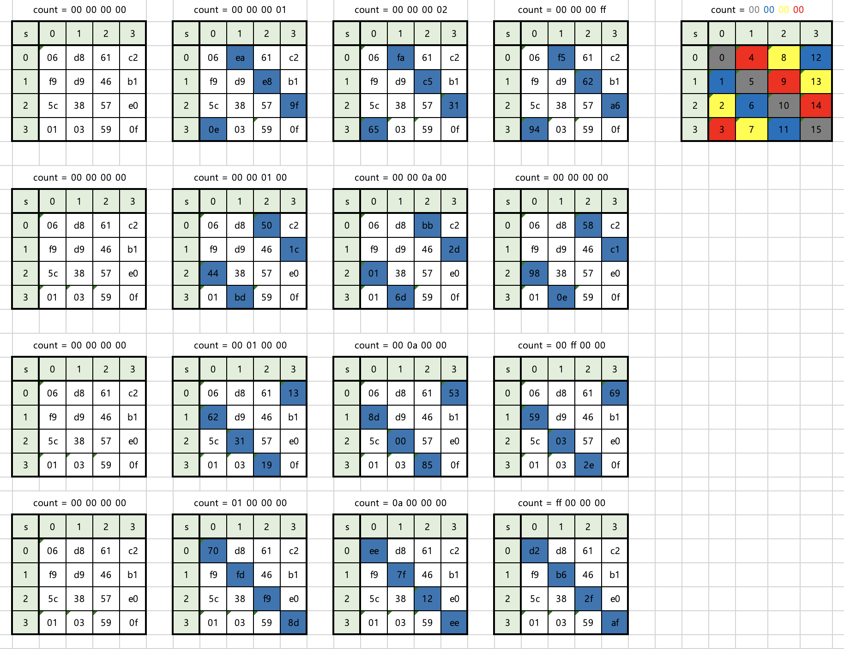
FixSlicing AES – CTR

Slide 8
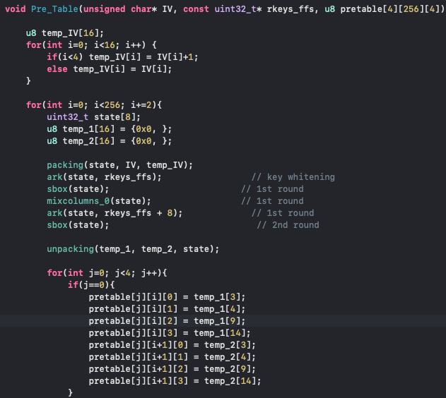
FixSlicing AES – CTR 구헌

Slide 9
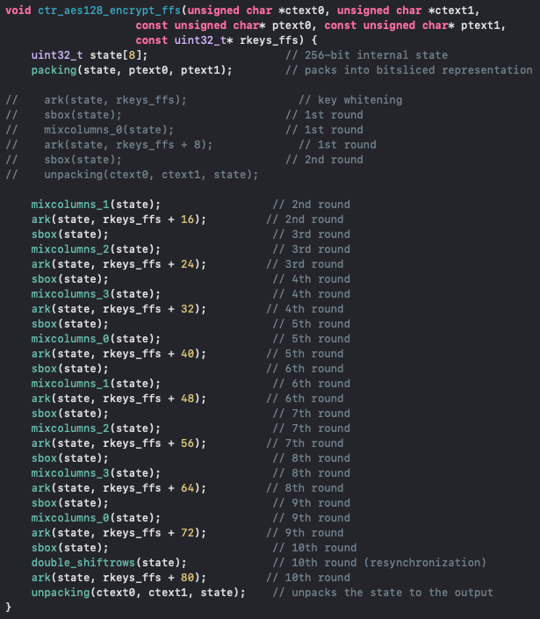
FixSlicing AES – CTR 구현

Slide 10
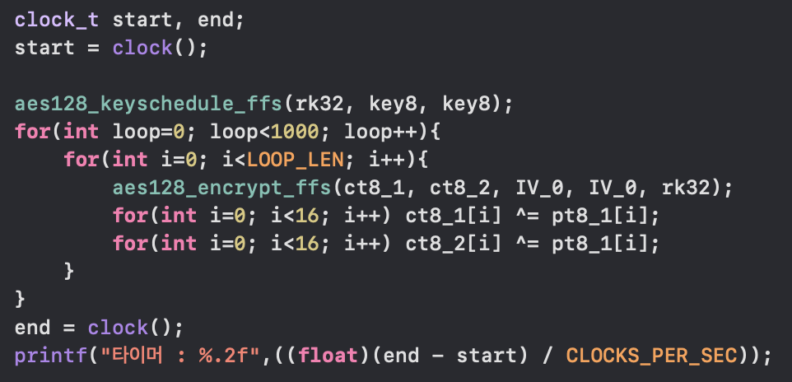
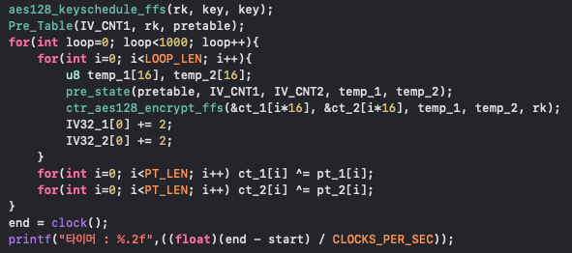
FixSlicing AES – CTR 성능
성능 테스트
1MB 암호화 1000번 반복
ECB : 약 43초
CTR : 약 36초
약 7초 정도의 차이 발생

Slide 11
질문…
count = 0
count = 1
count = 0
PT_1 / 128-bit
PT_2 / 128-bit
PT_1 / 128-bit
PT_2 / 128-bit
count = 2
count = 3
count = 1
PT_3 / 128-bit
PT_4 / 128-bit
PT_3 / 128-bit
PT_4 / 128-bit

